Slide 1
THE NEUTRAL NURSE: HOW INTERSECTIONS OF
NURSES’ IDENTITIES IMPACT CARE
Dr. Mel B. Freitag
University of Wisconsin-Madison
Wisconsin Association of School Nurses (WASN)
Opening Plenary,
April 23, 2015

Slide 3
LEADING FOR SOCIAL JUSTICE
Societal
Institutional
Personal
(Frattura & Capper, 2007)

Slide 4
Visual/Verbal
Beliefs
Dysconscious Racism
(Joyce King)

Slide 5
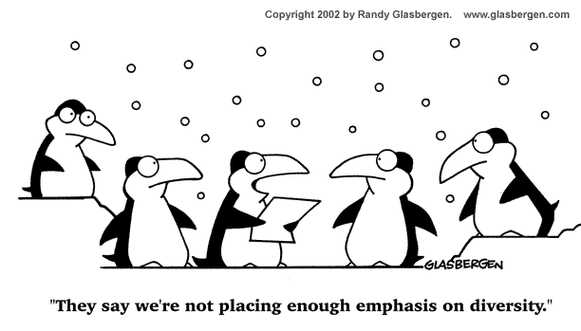
What is Diversity?

Slide 6
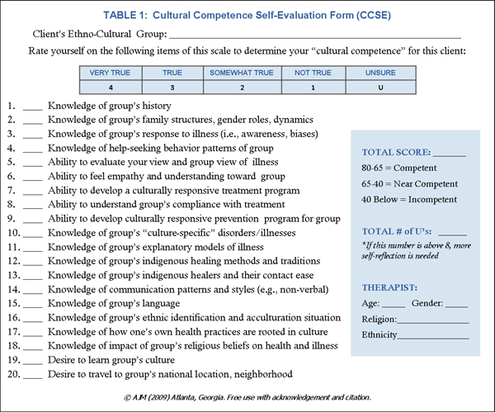
“Cultural Competency” in HealthCare
Cultural Knowledge
Cultural Sensitivity
Cultural Humility
Cultural Competency
Culturally Responsive
Culturally Relevant

Slide 7
Wisconsin White Women (WWW): Self Analysis and Reflexivity
The self,
regardless of its location,
is never exempt.
(Asher, 2007)

Slide 8
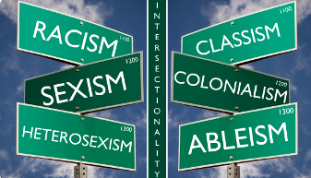
AXES OF IDENTITY
This theory seeks to examine how various biological, social, and cultural categories such as race, class, gender, and other “axes of identity” interact on multiple, simultaneous, and conflicting levels and platforms.
The “classic” -isms of society – racism, sexism, homophobia – do not act independently, but rather interdependently, of one another.
(Crenshaw, 1989; McCall, 2005)

Slide 9
INTERSECTIONS OF IDENTITY
Immigrant Status
Religion
Gender
Level of Education
Age
Culture
Native Language
Socioeconomic Status
Race and Ethnicity
Dis/ability
Sexual Orientation
Geographic Location
Mental Health

Slide 10
THE DANGER OF SILENCE

Slide 11
DIVERSITY DIALOGUES: SMALL GROUP EXERCISE (10 MINUTES)
What’s in a name?
Earliest memory of diversity
Positive experience
Awkward/challenging situation
Notes:
Modified Name exercise: Each participant introduce self and give a brief ‘backstory’ (history for one of your names, either first, middle, last name or nickname)
Form pairs (turn to right or left) and reflect on:
(a) recall your earliest memory related to diversity (e.g., first learned about people from other groups or some memorable incident, conversation, or interaction from early in life)
(b) recall a positive experience in your professional activities (or personal experience if you prefer) you had related to diversity (e.g., connecting with others across forms of diversity, learning something new related to some form of diversity)
Recombine group (and everyone should recall and share an awkward/challenging situation in your professional activities (or personal experience if you prefer) for you involving diversity (e.g., you said something that could or may have been perceived as insensitive, situation in which you didn’t know what to do/say, misunderstanding/misperception, or some other reason you felt uncomfortable).
Pose the question: What do you think will be your biggest challenge as in the Nursing profession related to Diversity? What is your biggest fear about diversity on your future career? Is there a group you’d feel most awkward around? Is there a topic that would make you nervous working with?

Slide 12
INSTITUTIONAL CHANGE: SCHOOL NURSES ASSESSMENT RESULTS
Overall, school nurses demonstrated the least amount of multicultural knowledge, training, and confidence. They had the most training and confidence in their consultation skills, but they had the least amount of training and confidence in the intervention skill areas.
In regards to minority specific skills, school nurses had little to no training across all of these areas. On the other hand, they had a little confidence in their ability to implement the skills needed to serve children who live in poverty. Therefore, the more training they had; the more confidence they had.
Notes:
Major Findings: School Nurses
Description of Sample
A total of 38 school nurses responded to this survey, which represented the fourth (16%) largest group of professionals in the sample. Most of the school nurses held bachelor’s degrees (76%) and had more than 20 years of experience (45%). Approximately 61% of the school nurses were located in rural CESAs. Approximately 58% of the nurses had multicultural coursework; however, most of them had not attended multicultural presentations (84%) or workshops (76%).
Motivation to Improve Multicultural Competence
Most of the school nurses (47%) reported a moderate level of motivation to improve their cultural competence. Approximately 34% had high motivation while 13% had very high motivation to improve. Only two nurses reported low or very low motivation to improve their cultural competence. Level of motivation was positively correlated with having coursework (.09) and attending presentations (.07)/workshops (.17). On the other hand, there was a negative correlation between level of motivation and years of experience (-.12). However, none of these correlations were significant.
Multicultural Knowledge
The average knowledge score among school nurses was 65% (SD=15.5), which was the lowest score among all professionals. There was not a significant difference in knowledge scores between school nurses in urban CESAs and those in rural CESAs. In addition, there was a small positive correlation between knowledge and level of motivation (.08), but the relationship between knowledge and years of experience was negative (-.024). Neither of these relationships was significant.
Extent of Multicultural Training and Confidence
The school nurses were asked to rate their extent of training (0-4) and level of confidence implementing those skills (0-4) in multicultural assessment (7 skills), consultation (8 skills), and intervention (6 skills). In addition to these skills questions, school nurses were also asked about their skills in serving specific minority populations, including linguistic minorities (7 skills), racial/ethnic minorities (12 skills), and children living in poverty (5 skills).
Multicultural Assessment Skills. On average, school nurses reported having little training (M=.97, SD=.71) or confidence (M=.94, SD=.55) in the seven multicultural assessment skills There was one skill where school nurses reported some training but little confidence: evaluating the influence of your own beliefs/perspectives. There was little training and confidence in evaluating the influence of the student’s beliefs/perspective on learning and behavior. There was no training and little to no confidence in the remaining assessment skills.
Multicultural Consultation Skills. School nurses reported a little training (M=1.42) and confidence (1.57) in these consultation skills. They reported some training and sufficient confidence in establishing relationships that are congruent with student’s beliefs/perspectives. There was also some training in determining a family/student’s attitude toward disability and understanding the beliefs/perspectives of other consultation members, but there was little confidence in implementing these skills. Nurses reported little training and confidence in determining how their own beliefs/perspectives influenced the problem and determining how the beliefs/perspective of other school personnel influenced the problem. There was no training in collecting data on beliefs/perspectives/values of others, but they had sufficient confidence in their ability to perform this task. There was also no training in modifying the consultation process based on the beliefs of the consultee or clients, but the confidence was comparatively higher (a little).
Multicultural Intervention Skills. On average, the school nurses reported no training (M=.86) or confidence (M=.93) in their multicultural intervention skills. Nurses did not report a lot of training, adequate training, or some training for any skills in this area. They reported a little training and confidence in identifying beliefs/perspectives that affect the acceptability of an intervention and using student’s strengths in intervention. However, there was no training and little confidence in all remaining skills.
Skills to Serve Linguistic Minorities. On average, school nurses reported no training (M=.29) or confidence (M=.38) in the skills needed to serve linguistic minorities. They did not report a lot, adequate, some, or a little training in any of the skill areas. They reported no training in all areas, but there was sufficient confidence in using an interpreter, while there was no confidence in implementing the remaining skills.
Skills to Serve Racial/Ethnic Minorities. School nurses, on average, reported no training (M=.36) or confidence (M=.41) in the skills needed to serve racial/ethnic minorities. The nurses did not report a lot, adequate, or some training in any of these skill areas. They reported a little in training and confidence in considering racial/ethnic identity during consultation. They reported no training for the remaining 11 skill areas with little to no confidence in implementing these skills.
Skills to Serve Students Living in Poverty. School nurses reported, on average, no training (.95) but a little confidence (1.09) in the skills needed to serve students who live in poverty. They did not report a lot, adequate, or some training in any of these skill areas. They reported a little training and confidence in assessing the influence of economic hardship on families/students, assessing the influence of poverty on learning and well-being. However, they reported no training in assessing poverty-related stress or designing interventions to reduce poverty-related stress.
School Nurses’ Knowledge, Training, and Confidence
In analyzing the relationship among school nurses’ multicultural knowledge, training, and confidence; there were significant, positive correlations between knowledge and extent of training (.26**) and knowledge and level of confidence (.23**). There was also a significant, positive correlation between the extent of training and level of confidence (.78**). Therefore, as the training of school nurses increased, their knowledge and confidence also increased.
Summary: School Nurses
Overall, school nurses demonstrated the least amount of multicultural knowledge, training, and confidence. They had the most training and confidence in their consultation skills, but they had the least amount of training and confidence in the intervention skill areas. In regards to minority specific skills, school nurses had little to no training across all of these areas. On the other hand, they had a little confidence in their ability to implement the skills needed to serve children who live in poverty. Therefore, the more training they had; the more confidence they had. The results for the nurses should be interpreted with caution because of the small sample of nurses. It is also important to note that some of the questions may have been perceived as being related to psychological testing and assessment, rather than being related to the nursing process. These questions need further study with the nurses.
Wisconsin Department of Public Instruction
Pupil Services Multicultural Needs Assessment
Final Report
Prepared By:
Markeda Newell, PhD
Assistant Professor, School Psychology
University of Wisconsin-Milwaukee
and
Joshua Looser, MS,
Doctoral Student, School Psychology
University of Wisconsin-Milwaukee

Slide 13
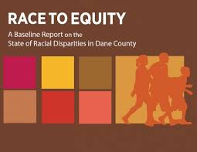
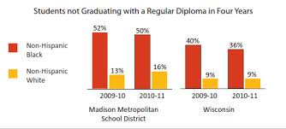
INSTITUTIONAL CHANGE: RACE TO EQUITY REPORT EDUCATION
African American children and youth make up about 20% of Madison’s public school enrollment and about 17% of the county’s total public school student population.
86% of the county’s Black 3rd graders tested below the proficiency level in reading in 2012.
21% of the county’s Black students were suspended compared to 2% of their White counterparts
Notes:
Infant mortality; uninsured; child poverty; incarceration;

Slide 14
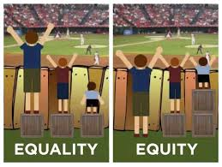
EQUALITY V EQUITY / MYTH OF MERITOCRACY

Slide 15
SYSTEMS: RACE VIDEO

Slide 16
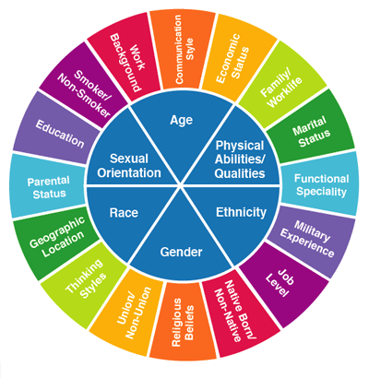
SOCIAL JUSTICE THEORY & EMBEDDED DIVERSITY
A vision of society in which distribution of resources is equitable and all members are physically and psychologically safe and secure.
Holistic approach – not just one multicultural “workshop” or one course
The ability to be uncomfortable in and out of school
(Adams, Bell, and Griffin)

Slide 17
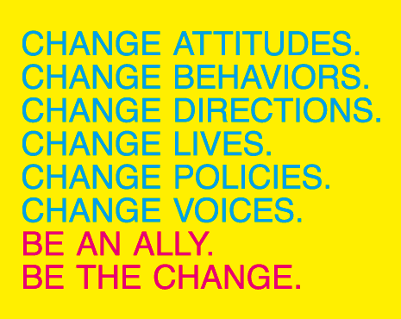
5 TIPS FOR BEING AN ALLY

Slide 18
HOW CAN THIS BE ACCOMPLISHED?
How are underrepresented patients/people are portrayed in promotional materials (websites, brochures, textbooks, posters)
Active Learning, Team Building, Project- and community-based problem solving
Social identity awareness – comfort with ambiguity
Allyship within healthcare – how is this different from advocacy?

Slide 19
HOW CAN THIS BE ACCOMPLISHED?
Develop a working definition of “inclusive communities” and culturally congruent care
Implement and assess policies and programs that create and sustain a more inclusive climate for teachers AND students
Design and implement a system of accountability and recognition for increasing diversity and forming a more inclusive community
Adapted from: To Form a More Inclusive Community, CSU, Diversity Action Plan 2016 by Diversity Scorecard Committee, December 2011

Slide 20
THE TRUE FOCUS OF REVOLUTIONARY CHANGE IS NEVER MERELY THE OPPRESSIVE SITUATIONS WHICH WE SEEK TO ESCAPE, BUT THAT PIECE OF THE OPPRESSOR WHICH IS PLANTED DEEP WITHIN ALL OF US. AUDRE LORDE, SISTER OUTSIDER, 123

Slide 21
MEL B. FREITAG, PHD DIRECTOR OF DIVERSITY, SCHOOL OF NURSING UNIVERSITY OF WISCOSIN-MADISON MBFREITAG@WISC.EDU WWW.MELFREITAG.COM/DIVERSITY

